Slide 1
Bow Exercises for Beginning, Intermediate, and Advanced Students
Presenters:
Bryant Hayden (Computer Science, Double Bass) and Jonathan New (Music Education, Violin)
Pacific University String Project
ASTA National Conference 2022
NSPC Best Practices Session

Slide 2
Overview
Introductions
System of Springs
Bowing Exercises for Beginning Students
Bowing Exercises for Intermediate Students
Bowing Exercises for Advanced Students
Q&A

Slide 3
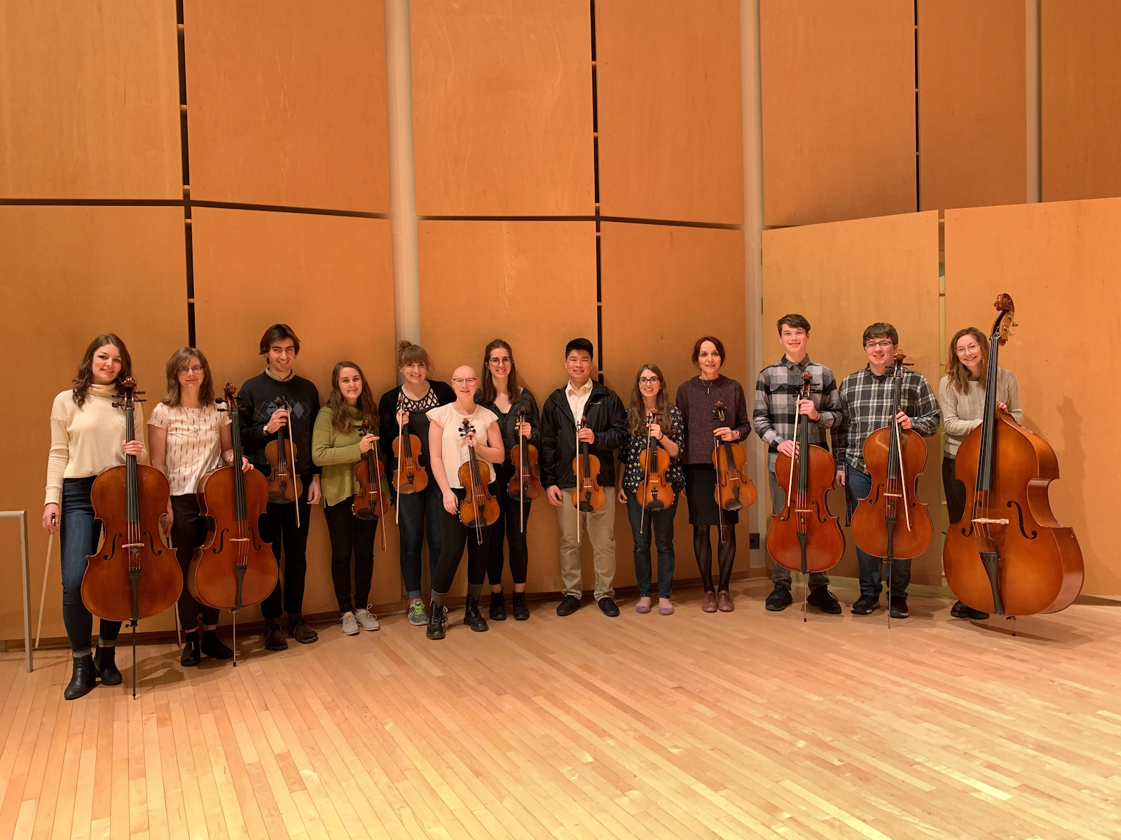
Introductions
Bryant Hayden Computer Science, Double Bass
Jonathan New Music Education, Violin

Slide 4
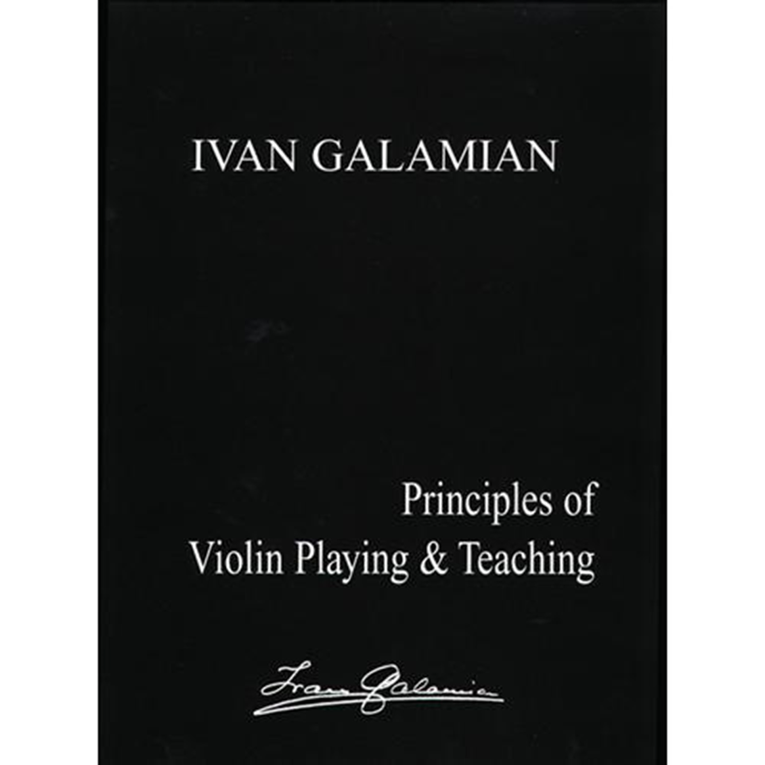
System of Springs
“To understand the functioning of the bow, one must realize
from the very outset that the whole right arm technique is based on a system of springs.”
(Galamian, 1985, 44)

Slide 5
Bowing Exercises for Beginning Students
Objectives:
Exercises:

Slide 6
Bowing Exercises for Intermediate Students
Objectives:
Exercises:

Slide 7
Bowing Exercises for Advanced Students
Objectives:
Exercises:

Slide 8
Q&A
Thank You

